Slide 1
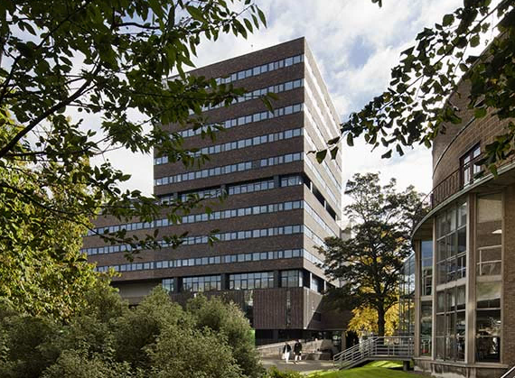

Slide 2
Week 3
Comparisons and Associations

Slide 3
Assignment Questions
A. Are religious people more satisfied with life?
B. Are older people more likely to see the death penalty as justifiable?
C. What factors are associated with opinions about future European Union enlargement among Europeans?
D. Is higher internet use associated with stronger anti-immigrant sentiments?
E. How does victimisation relate to trust in the police?
F. What factors are associated with belief in life after death?
G. Are government/public sector employees more inclined to perceive higher levels of corruption than those working in the private sector?

Slide 4

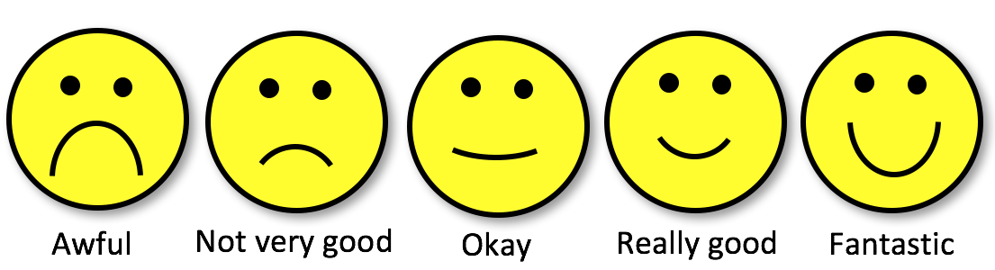
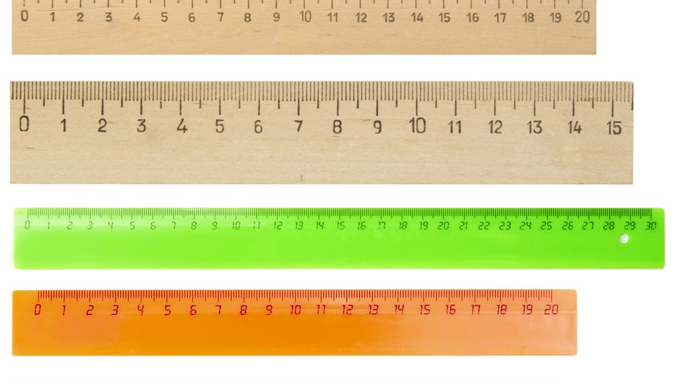
Variable types (review)
Categorical/
Nominal
Categorical/
Ordinal
Scale

Slide 5
Contingency tables (crosstabulation)
Cross-tabulations are tables that show the relationship between two variables. They are also called contingency tables or joint frequency tables; or “cross-tabs” for short. Cross-tabulations are essentially a series of side-by-side frequency tables. They present a frequency distribution of one variable for each category of another variable

Slide 6
Contingency tables (crosstabulation)
Cross-tabulations are tables that show the relationship between two variables. They are also called contingency tables or joint frequency tables; or “cross-tabs” for short. Cross-tabulations are essentially a series of side-by-side frequency tables. They present a frequency distribution of one variable for each category of another variable

Slide 7
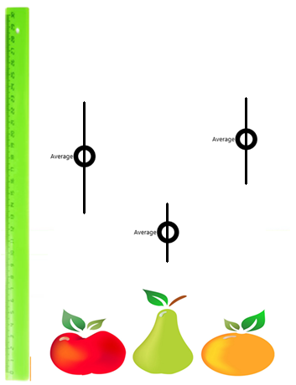
One categorical and one Scale variable: Error-bar graph Box-plots
Box-plots or error-bar graphs are useful for visualising the relationship between a Scale and a Categorical type variable
The plots will compare measures of central tendency and dispersion of the Scale-type variable across the categories of the categorical variable

Slide 8
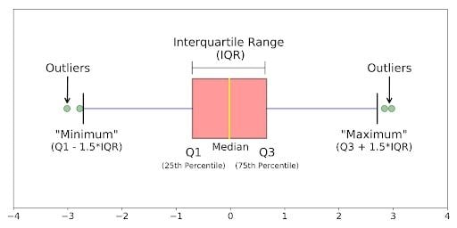
One categorical and one Scale variable: Error-bar graph Box-plots
Typically, box-plots depict the median value of the Scale variable, its Interquartile Range, the minimum and maximum values, and any outliers
What are these (again)?

Slide 9
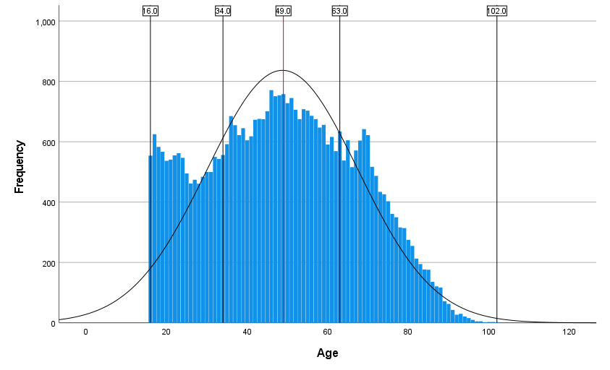
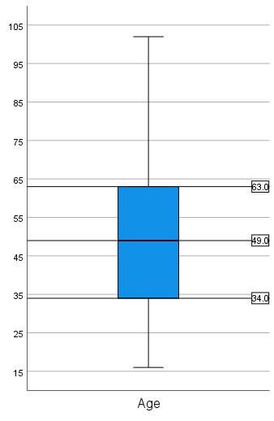
Percentiles and the IQR
Median = 50th percentile (P50)
P25
P75
Interquartile range (IQR) = P75 - P25
Notes:
While mean is ‘average’, median is the one in the ‘middle’; the 50th percentile; means 50% of the data is below the P50 value;
Divide each half into two again to get P25 and P75; the data is split into 4 quartiles;
The range between P25 and P75 measures the amount of data in middle 50%.
Boxplots specifically designed to capture this information.

Slide 10
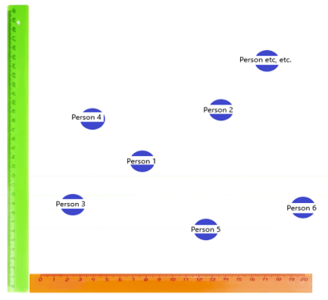
One categorical and one Scale variable: Error-bar graph Scatterplots
Scatter plots are most useful for capturing the relationship between two Scale-type variables
They are a visual representation of the joint dispersion of two numeric variables
They can give an indication of the “co-variance” or “correlation” between the two variables

Slide 11
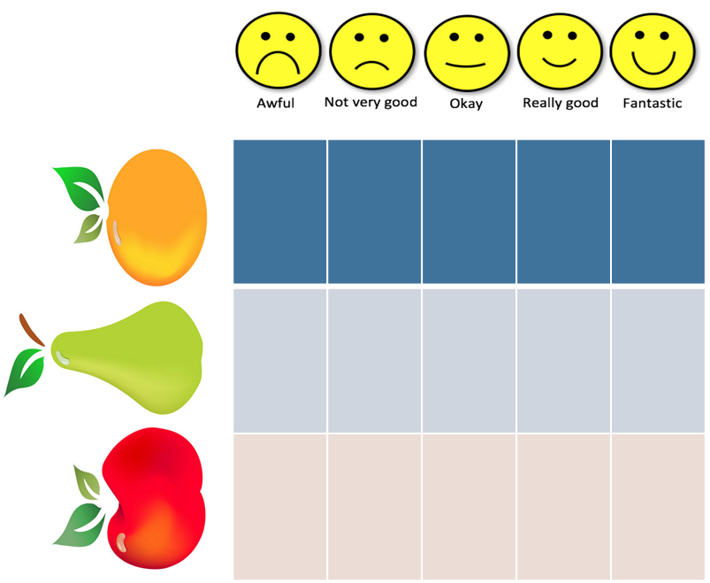
Strength and direction of association
In contingency tables:
The greater the differences in the proportions compared, the stronger the association between the two variables
Comparing means:
The greater the difference between the group averages, the stronger the association between the two variables
On scatterplots:
The more dispersed the data points are from an imaginary line approximating the overall average, the weaker the association between the two variables.
If the imaginary line is ascending, the association is positive in its direction (the two variables change in the same direction); if the line is descending, the association is negative

Slide 12
Dependent and independent variables
Underlying most bivariate descriptions is an assumed relationship between independent (or explanatory or predictor) and dependent (or outcome) variables.
We are assuming that one variable can help explain another (e.g. place of residence can explain satisfaction with one’s financial situation, rather than the other way around.
More often than not, the direction of the relationship (i.e. which one is the independent and dependent variable) is less straightforward and a matter of choice for the researcher derived from theory.
Independent
Columns
Dependent
Rows

Slide 13
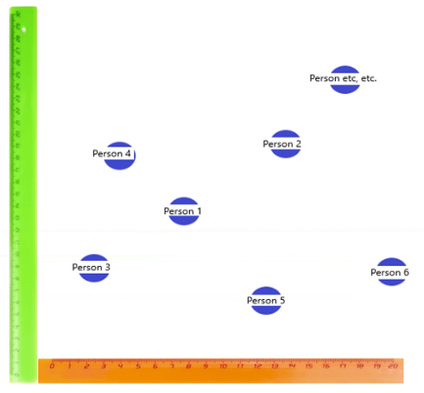
Dependent and independent variables
Underlying most bivariate descriptions is an assumed relationship between independent (or explanatory or predictor) and dependent (or outcome) variables.
We are assuming that one variable can help explain another (e.g. place of residence can explain satisfaction with one’s financial situation, rather than the other way around.
More often than not, the direction of the relationship (i.e. which one is the independent and dependent variable) is less straightforward and a matter of choice for the researcher derived from theory.
Dependent
Y-axis
Independent
X-axis

Slide 14
Is inequality affecting social trust?

Slide 15

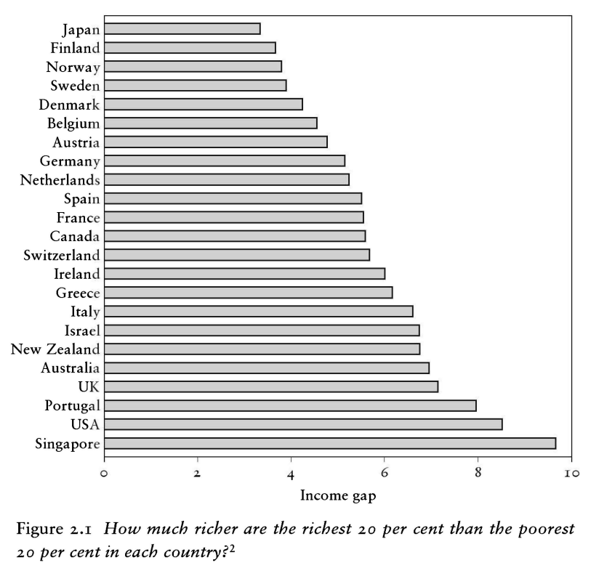
“The spirit level” (2010)

Slide 16
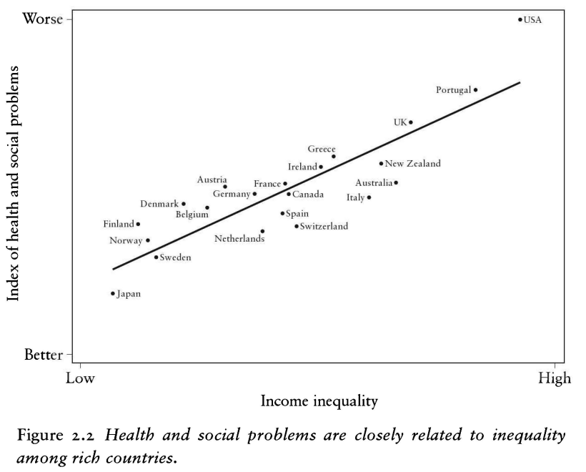
“The spirit level” (2010)

Slide 17
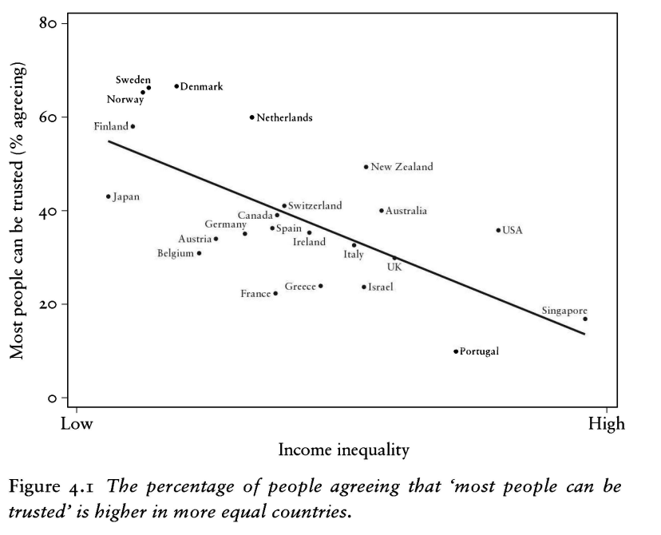
“The spirit level” (2010)

Slide 18
“The spirit level” (2010)
Variable | Mean | SD | IQR | Range | Skewness | Kurtosis | n | n_Missing ------------------------------------------------------------------------------------------------------------ trust_pct | 25.73 | 18.41 | 21.14 | [2.14, 77.42] | 1.13 | 0.62 | 89 | 0 GDP_pc | 27447.01 | 21342.56 | 28284.55 | [1987.97, 1.23e+05] | 1.62 | 4.20 | 86 | 3 pop_n | 5.78e+07 | 1.58e+08 | 4.68e+07 | [73837.00, 1.40e+09] | 7.32 | 61.13 | 87 | 2 urban_pop_pct | 67.92 | 18.93 | 25.93 | [20.31, 100.00] | -0.49 | -0.38 | 87 | 2 inc_top20 | 42.69 | 5.09 | 6.80 | [34.56, 57.35] | 0.86 | 0.42 | 79 | 10 inc_bottom20 | 7.15 | 1.62 | 2.32 | [3.45, 10.08] | -0.19 | -0.69 | 79 | 10 s80s20 | 6.50 | 2.60 | 2.79 | [3.52, 16.64] | 1.67 | 3.50 | 79 | 10

Slide 19
“The spirit level” (2010)
Descriptive Statistics
 |  | trust_pct |  | inequality_s80s20
Valid |  | 89 |  | 79
Missing |  | 0 |  | 10
Mean |  | 25.731 |  | 6.504
Std. Deviation |  | 18.406 |  | 2.597
Minimum |  | 2.140 |  | 3.517
Maximum |  | 77.420 |  | 16.644

Slide 20
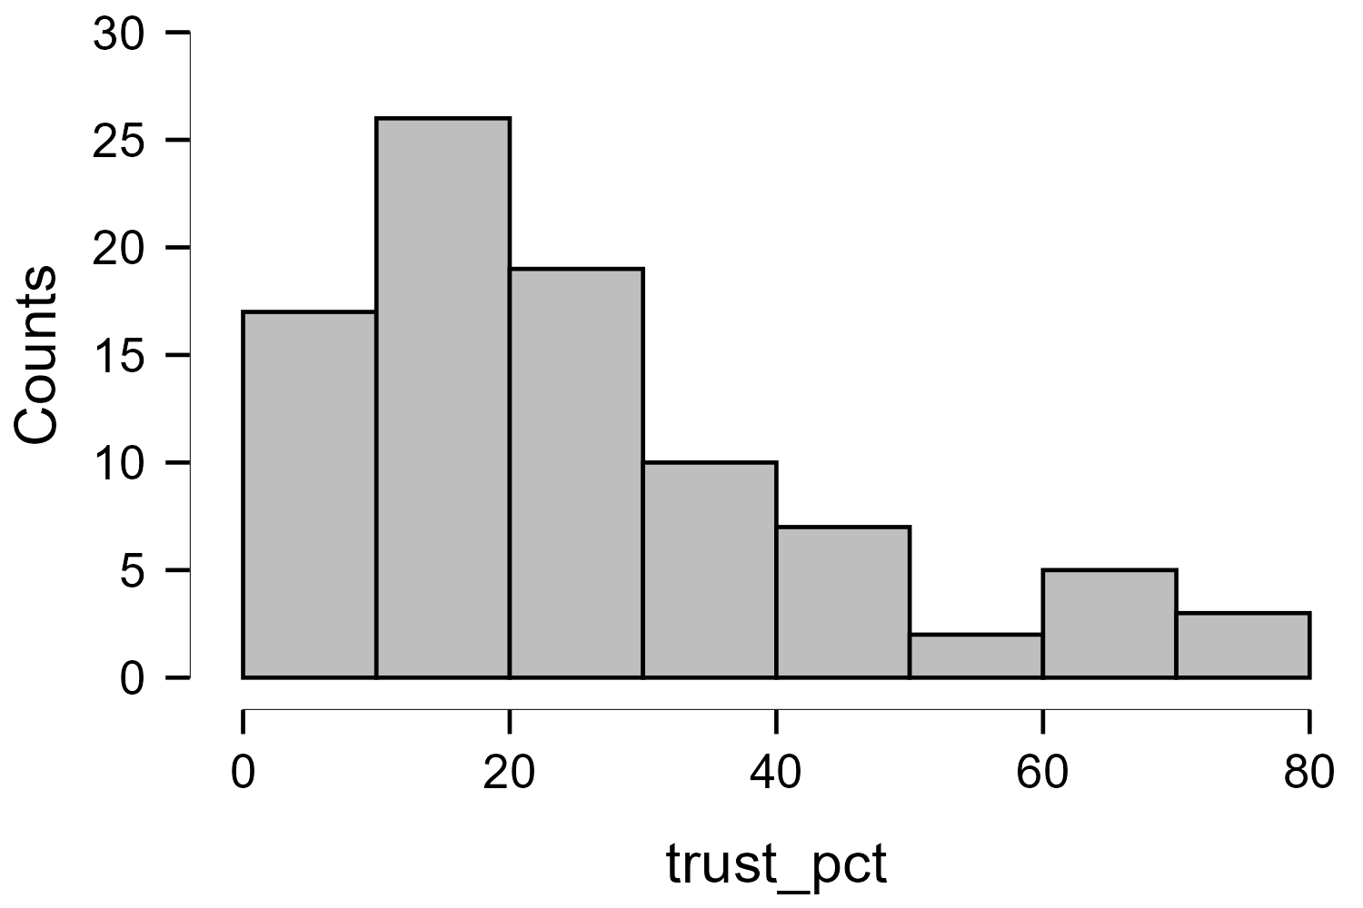
“The spirit level” (2010)
trust_pct

Slide 21
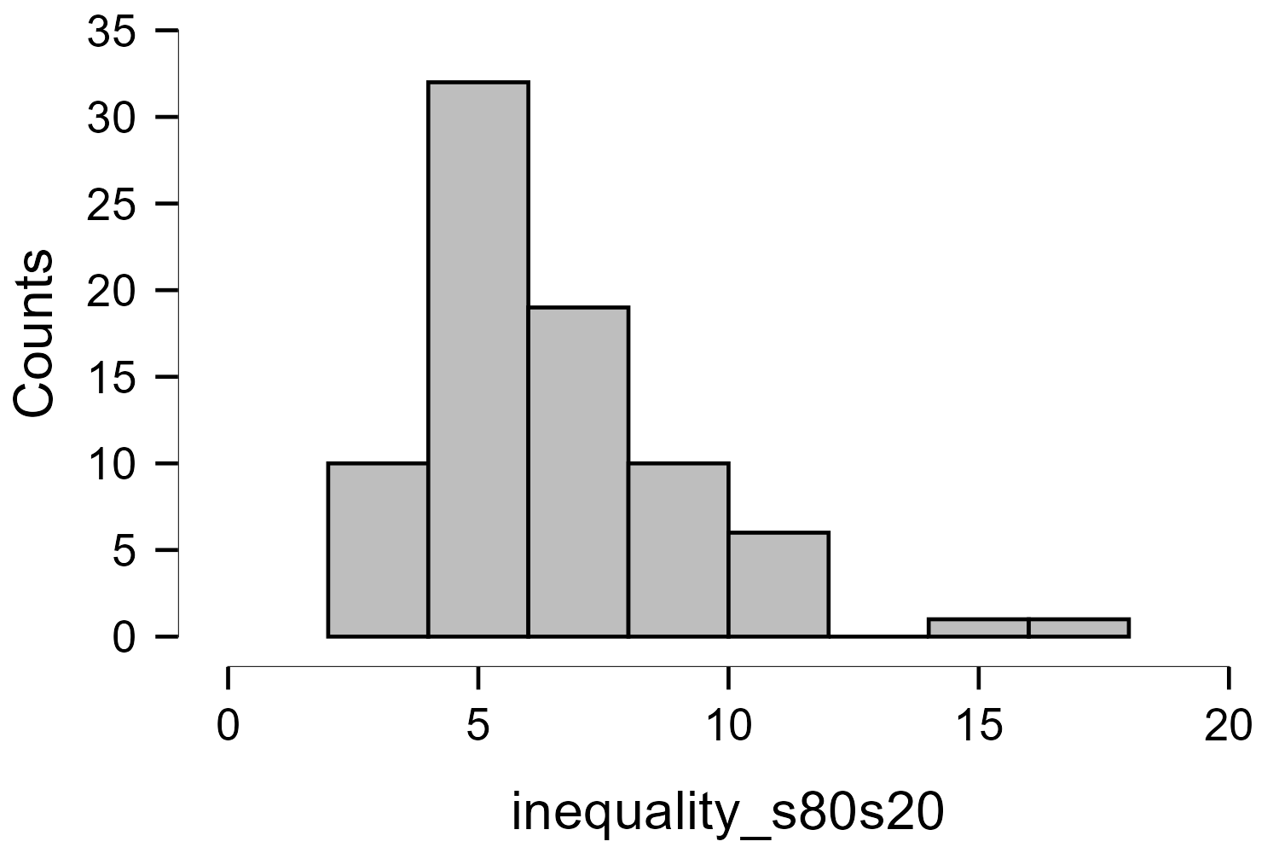
“The spirit level” (2010)
trust_pct

Slide 22
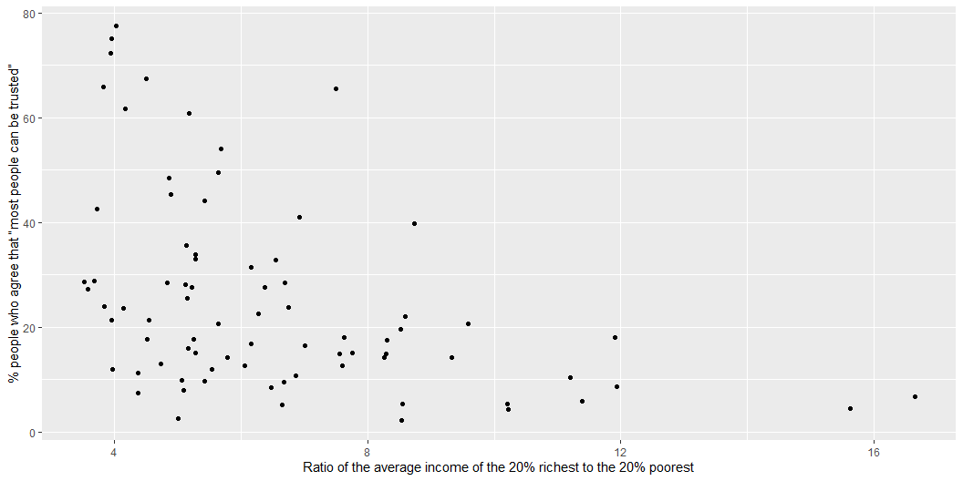

Slide 23
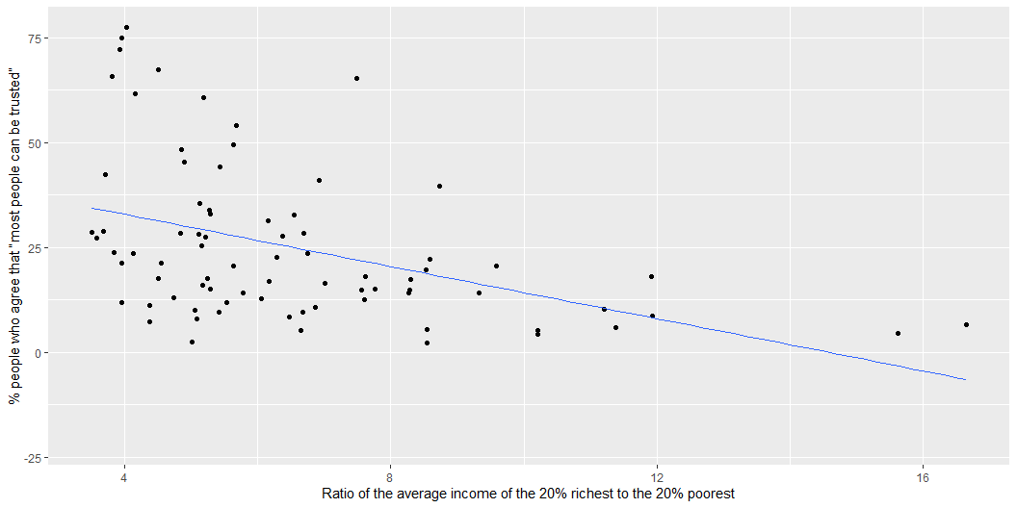

Slide 24
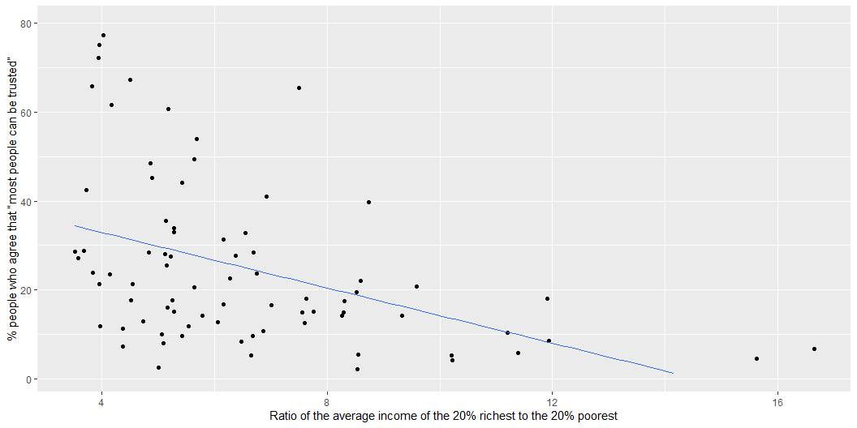

Slide 25
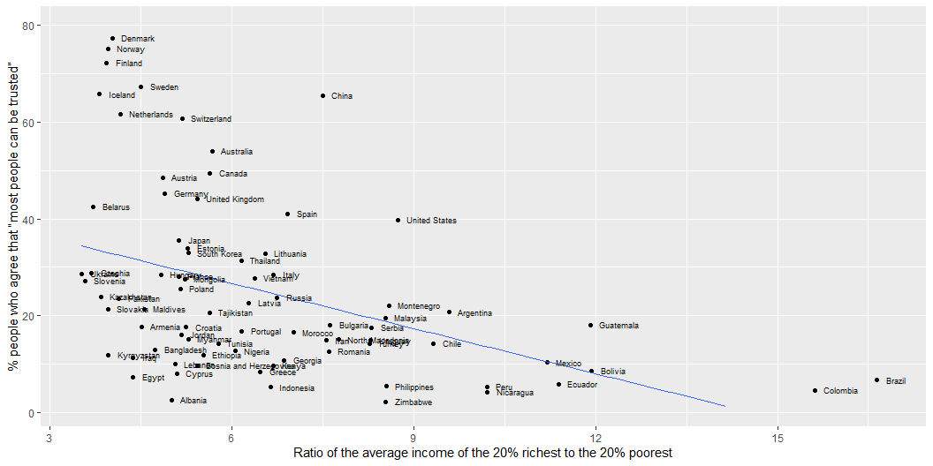

Slide 26
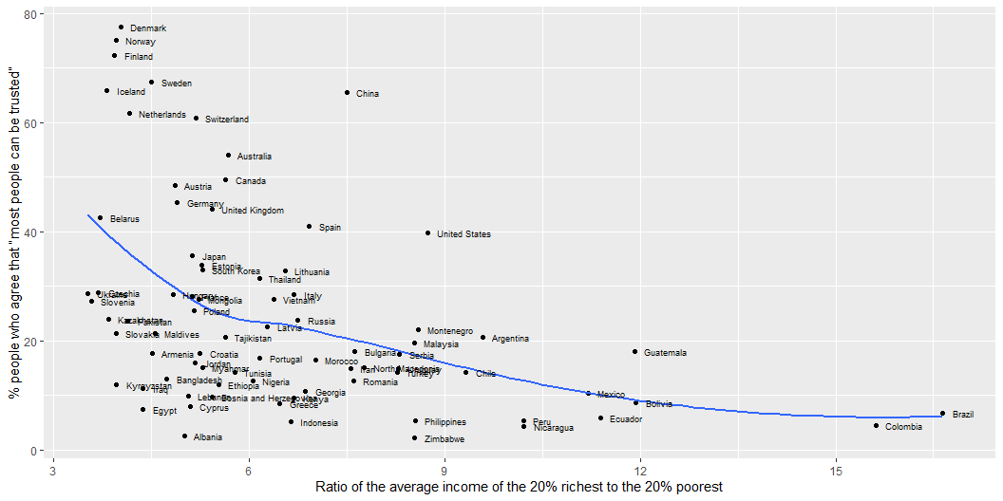

Slide 27
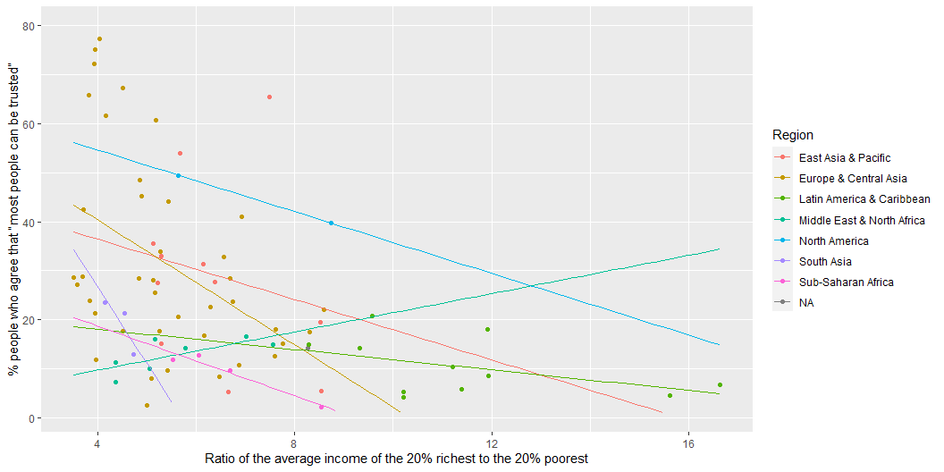

Slide 28
Workshop
1-3pm

